Slide 1
OPT8241 EVD Kit tech tips
Honglei.Yan
2018-08-22
Doc: OPT8241 Evaluation Module_sbou155a

Slide 2
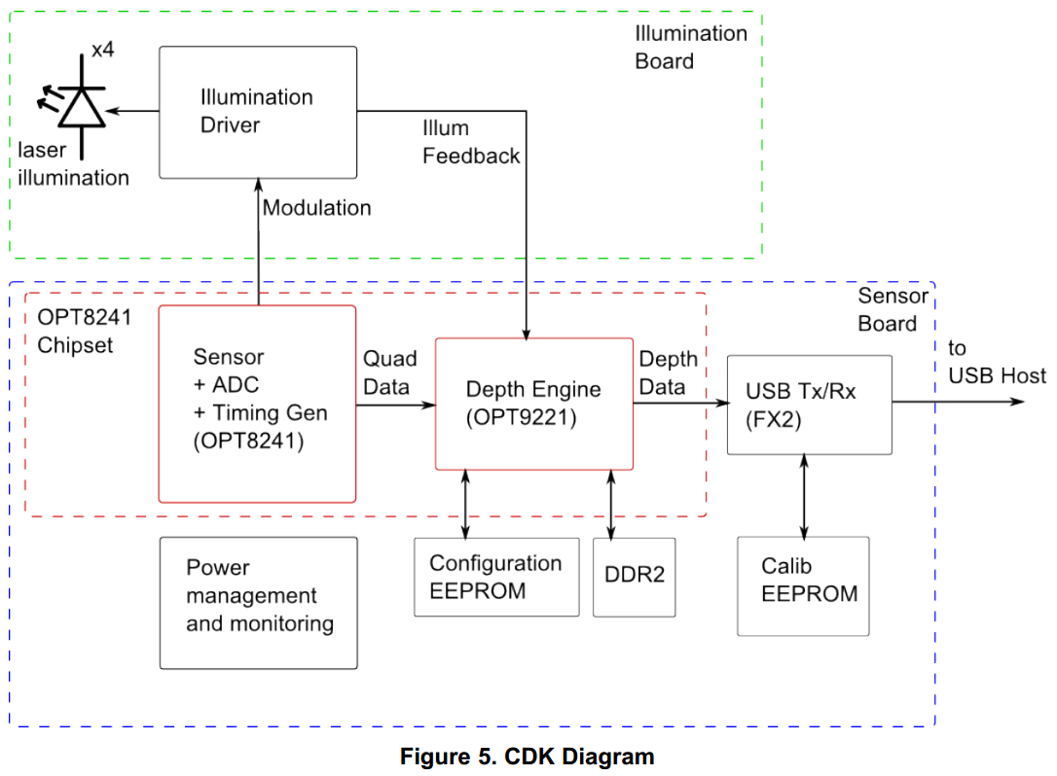
System Architecture

Slide 3
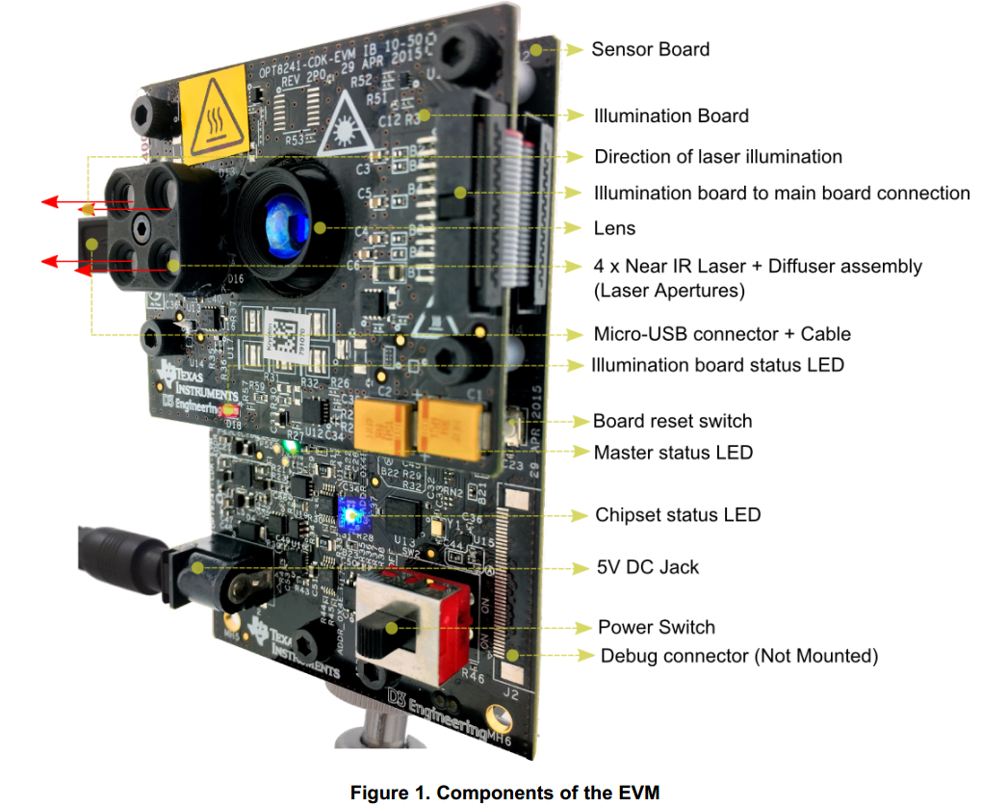
Evaluation Kit

Slide 4
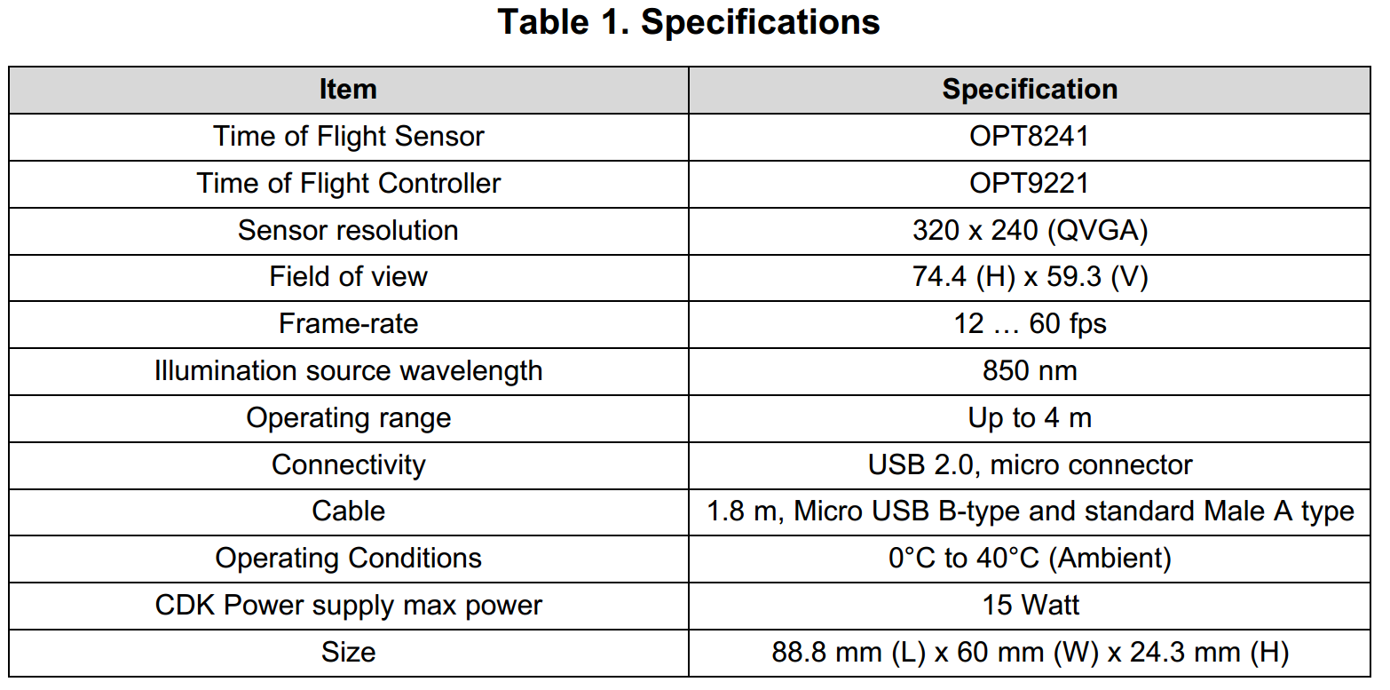
Specifications

Slide 5
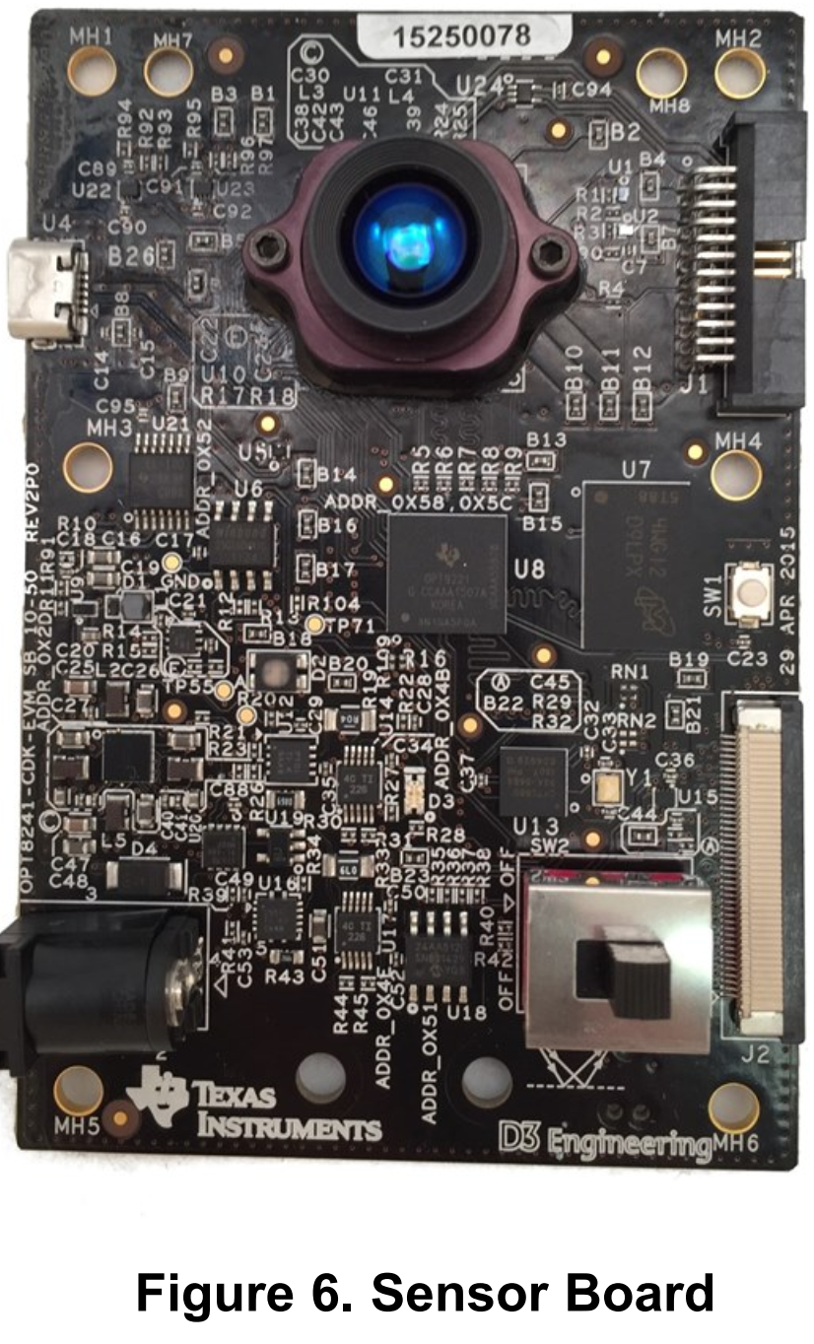

Sensor Board

Slide 6
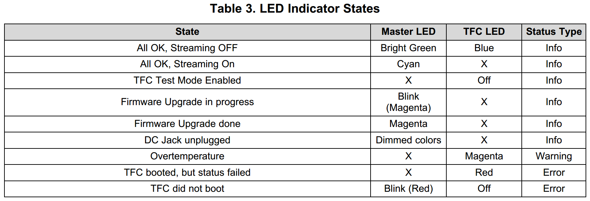
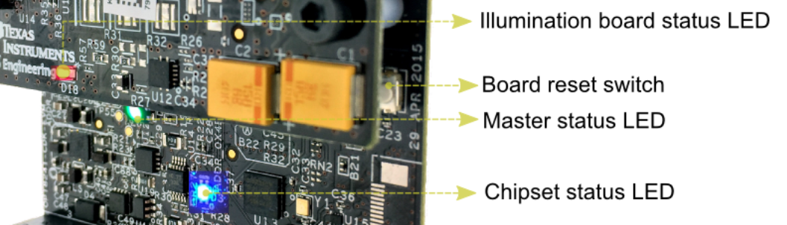
Indicator LEDs

Slide 7
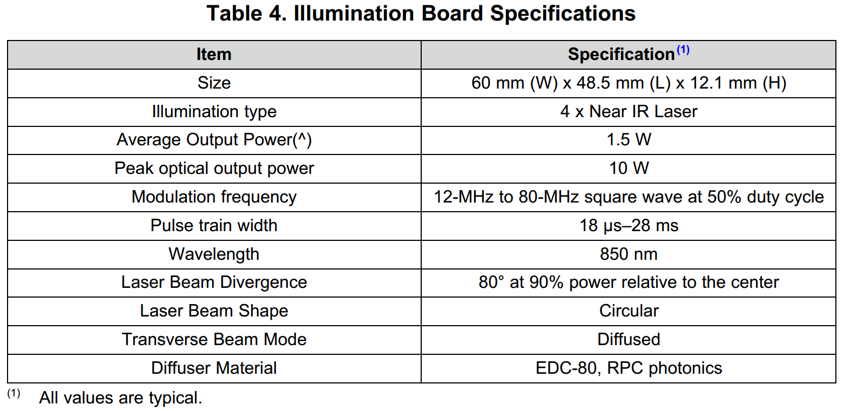
Illumination Board

